Slide 1
Topological Reasoning
Jonathan Lo, Tommaso Peletta, Adrien Razurel

Slide 2





A Spatial Model Checker
Model
Model Checker
Result
$$φ$$
Formula

Slide 3
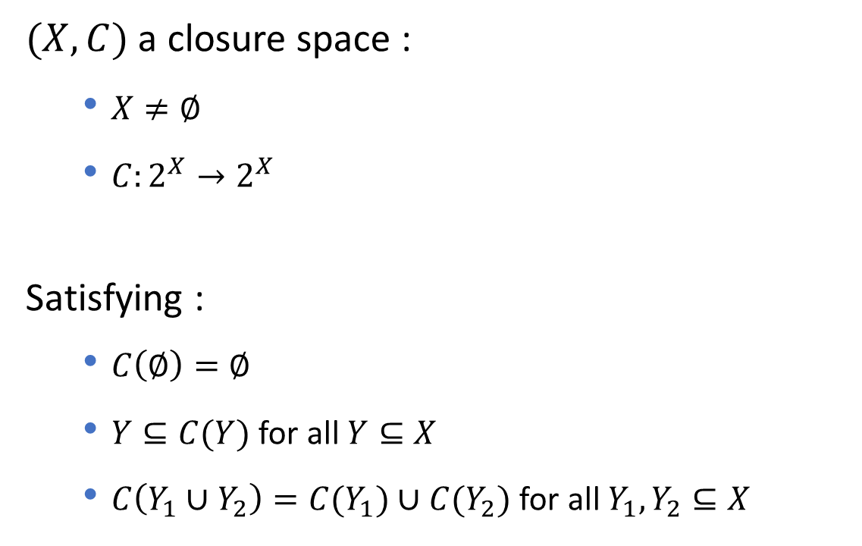
Closure space
$(X,C)$ a closure space :
$X≠∅$
$C:2^{X}→2^{X}$
Satisfying :
$C\left(∅\right)=∅$
$Y⊆C(Y)$ for all $Y⊆X$
$C\left(Y_{1}∪Y_{2}\right)=C(Y_{1})∪C(Y_{2})$ for all $Y_{1}, Y_{2}⊆X$

Slide 4
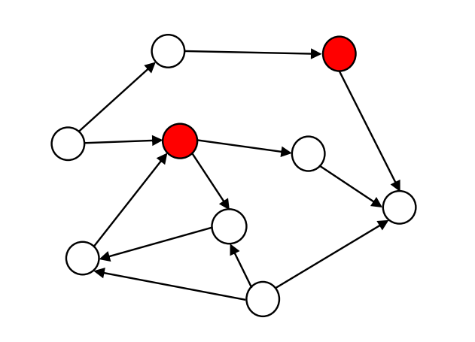
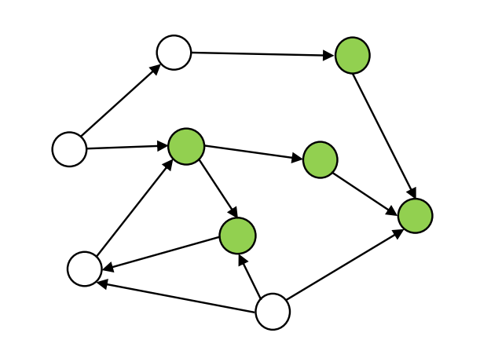
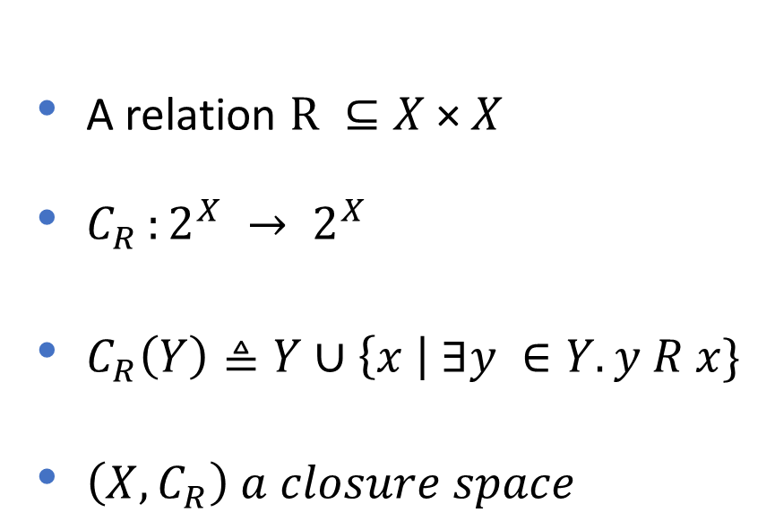
Quasi-discrete closure space
A relation $R ⊆X \text{×} X$
$C_{R }:2^{X} → 2^{X}$
$C_{R}\left(Y\right)≜Y∪\left\{x \right| ∃y ∈Y.y R x\}$
$\left(X,C_{R}\right) a closure space$

Slide 5

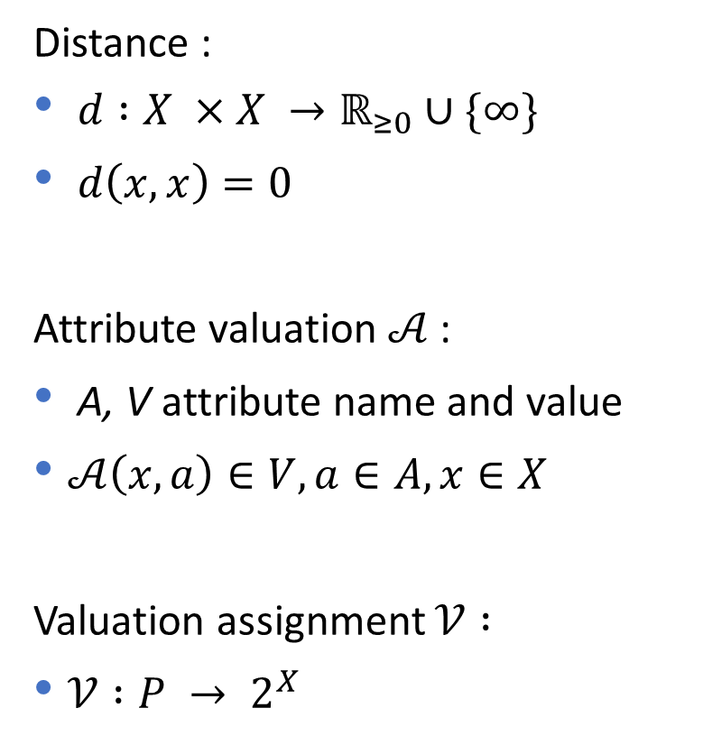

Enrichment
Distance :
$d :X ×X →ℝ_{≥0}∪\{∞\}$
$d\left(x,x\right)=0$
Attribute valuation $𝒜$ :
A, V attribute name and value
$𝒜\left(x,a\right)∈V, a∈A, x∈X$
Valuation assignment $𝒱 :$
$𝒱 :P → 2^{X}$
$$x$$
$$𝒜\left(x,color\right)=red$$

Slide 6
Satisfaction of a formula
z
y
z
y
w
x
c
w
x
c
b
b
d
d
t
t
a
a
Red
{x,y}
Red
{a,b,c,d,t,w,z}

Slide 7
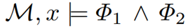
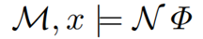
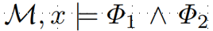
Satisfaction of a formula
z
y
z
y
w
x
c
w
x
c
b
b
d
d
t
t
a
a
Red
Green
{x}
Red
{c,d}

Slide 8
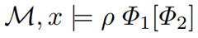
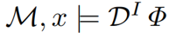

Satisfaction of a formula
z
y
z
y
w
x
c
w
x
c
b
b
d
d
t
t
a
a
$$𝒟^{≤2}$$
{d,c,b,t}
Green [Red]
{w,z}
Red

Slide 9


Derived operators: flt
$$Original image$$

Slide 10


Derived operators: flt
$$not(image)$$

Slide 11

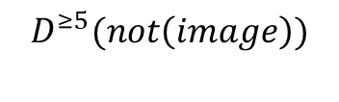
Derived operators: flt
$$D^{≥5}(not\left(image\right))$$

Slide 12

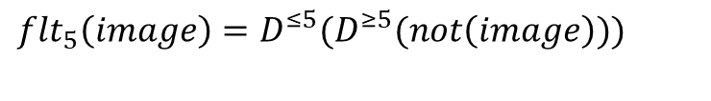
Derived operators: flt
${{flt_{5}\left(image\right)=D}^{≤5}(D}^{≥5}(not\left(image\right)))$

Slide 13
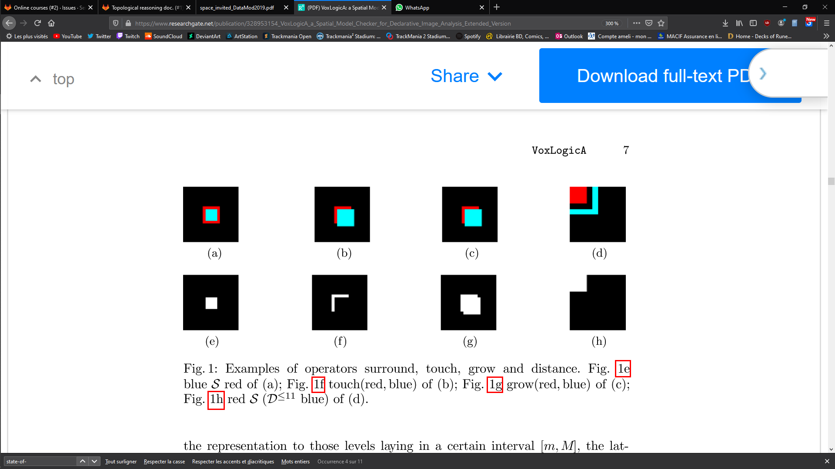




Other derived operators
blue$𝓢$red
$$\text{touch}\text{(}\text{red}\text{,}\text{blue}\text{)}$$
$$\text{grow}\text{(}\text{red}\text{,}\text{blue}\text{)}$$
$$\text{red} 𝓢 \text{(}𝒟^{≤11} \text{blue}\text{)}$$

Slide 14
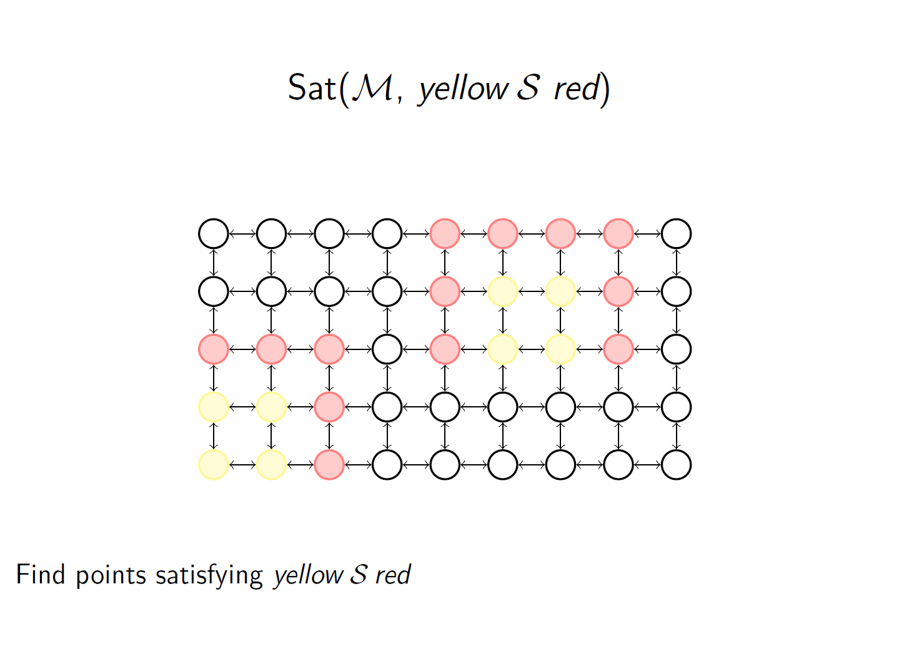
Example

Slide 15
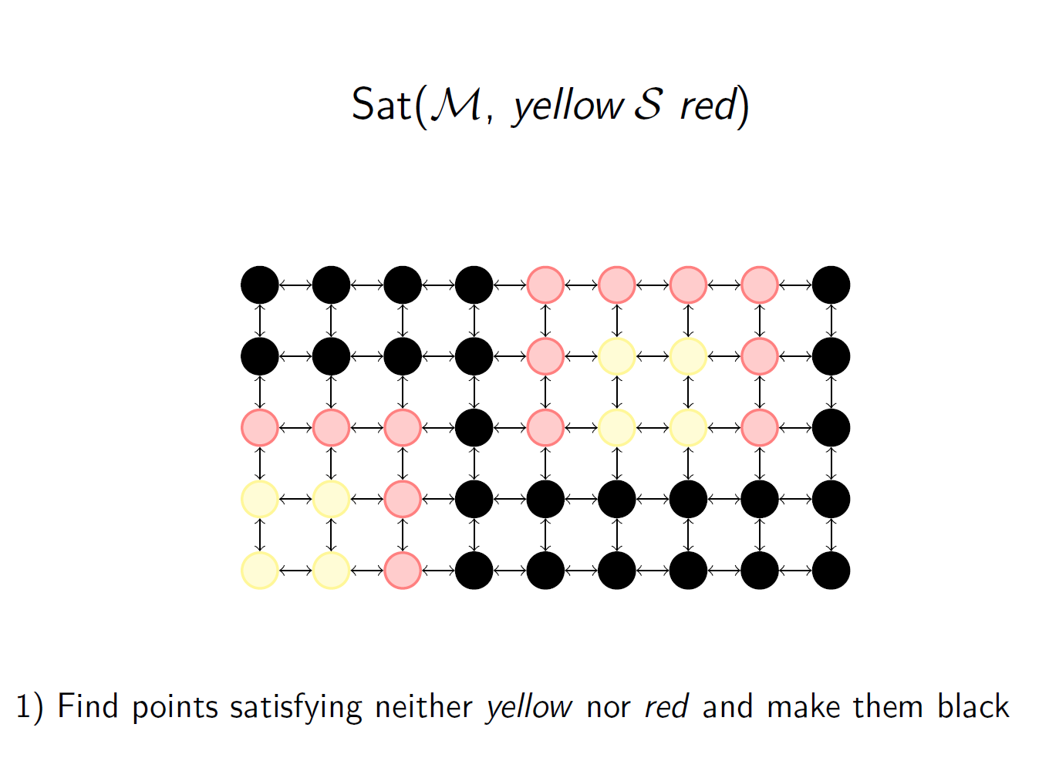
Example

Slide 16
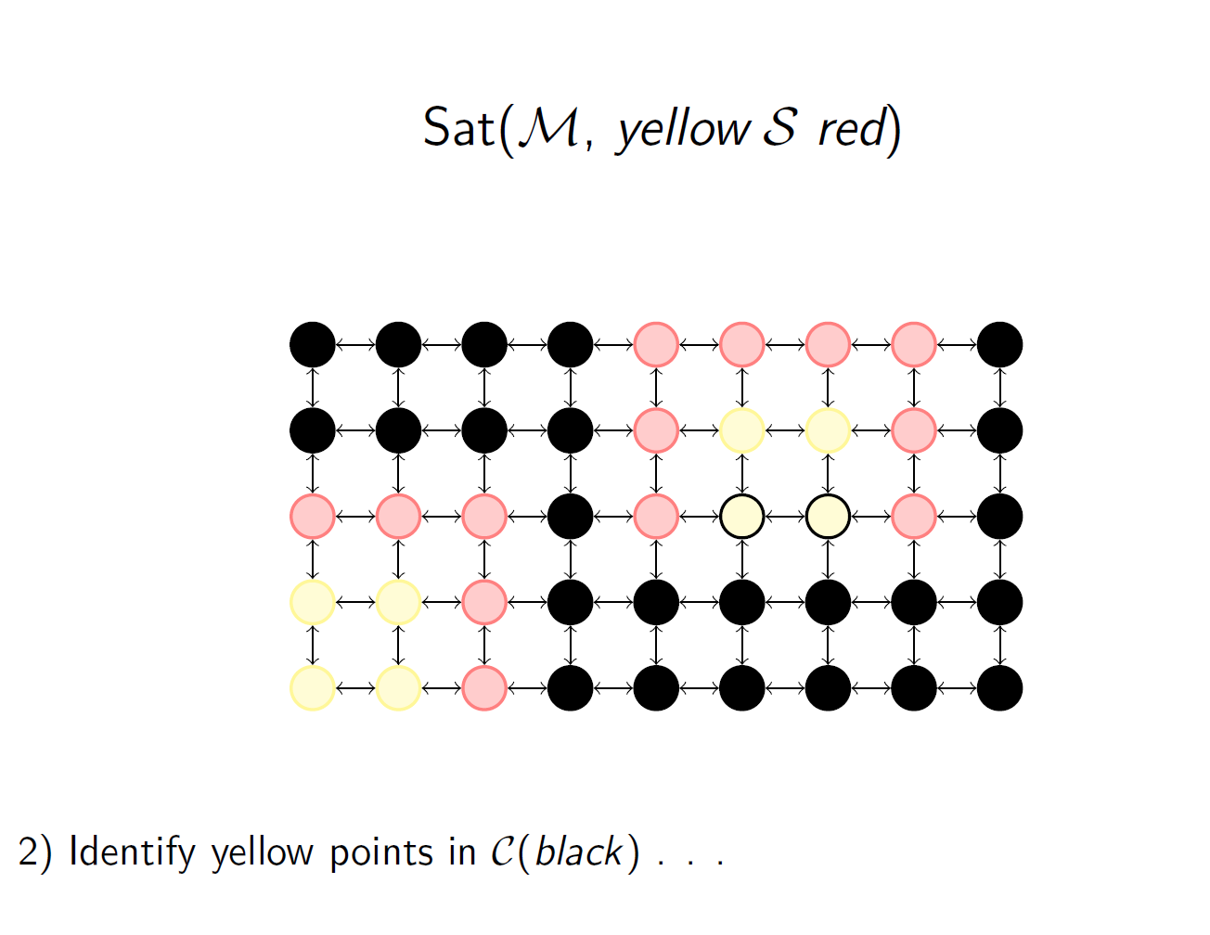
Example

Slide 17
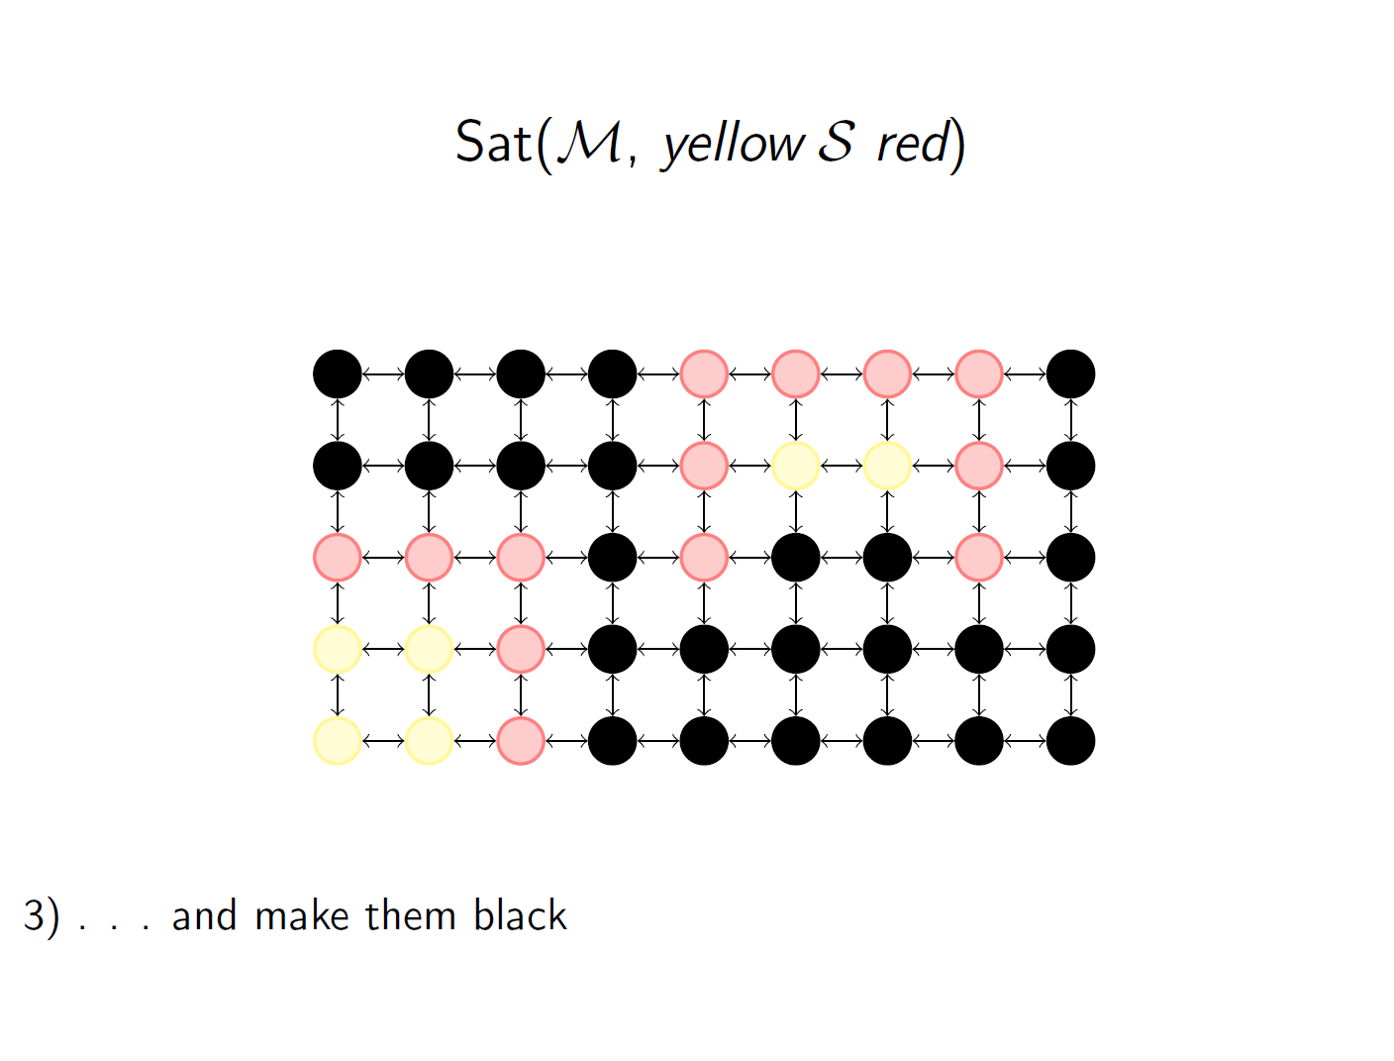
Example

Slide 18
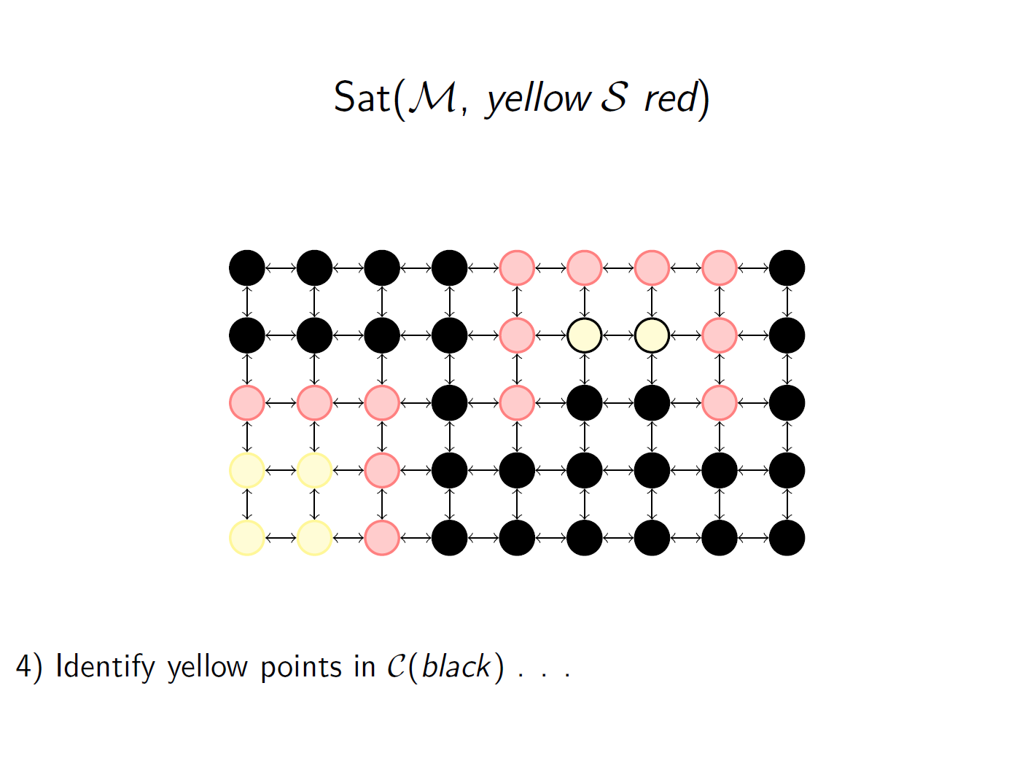
Example

Slide 19
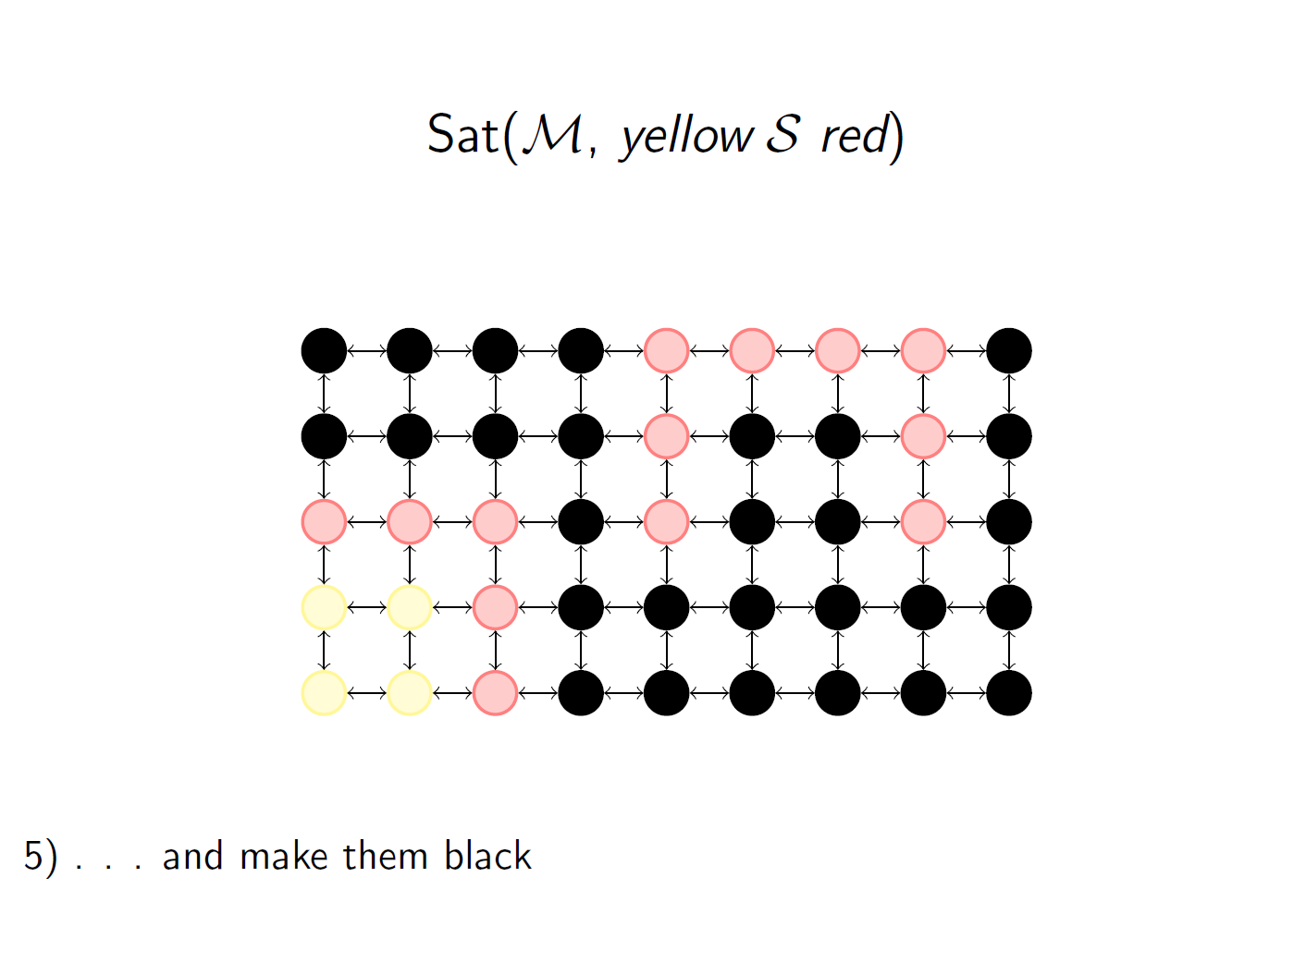
Example

Slide 20
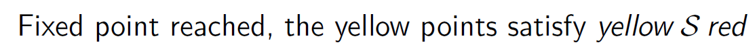
Example

Slide 21
VoxLogica (Voxel-based Logical Analyser)
Spatial Model Checker
Image analysis tool using logic language
Can reach state-of-art performance

Slide 22
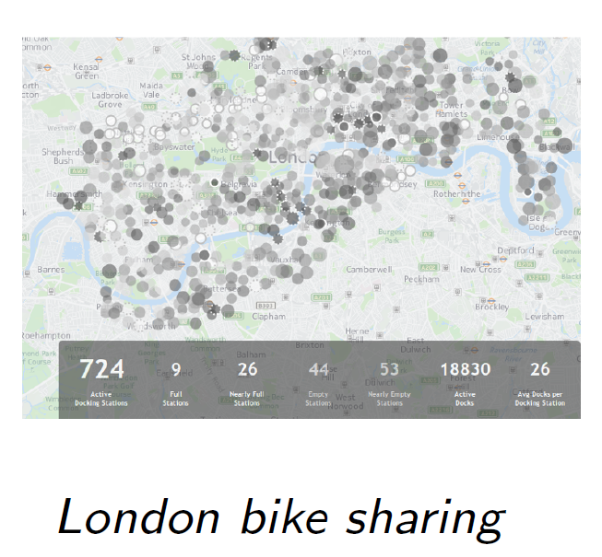
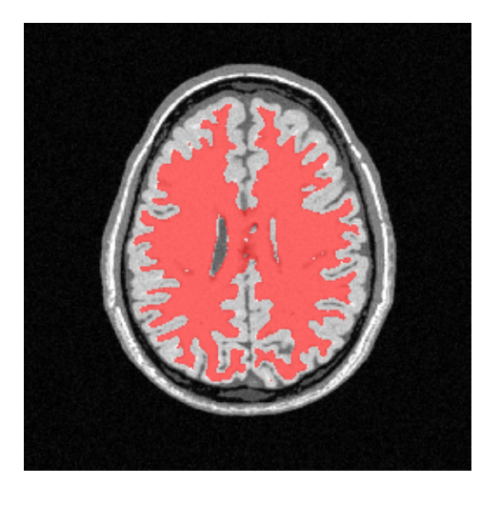
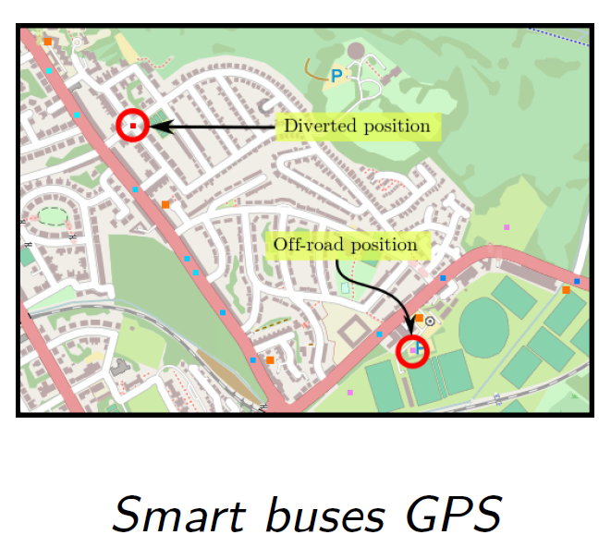
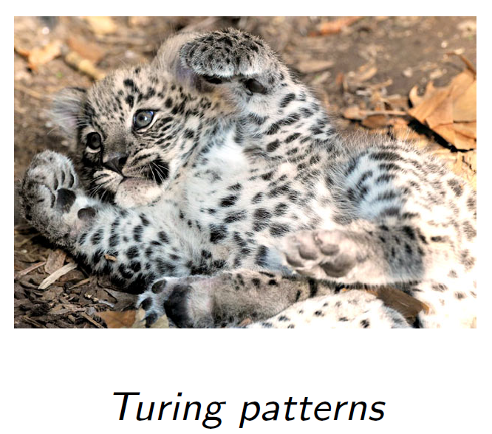
Existing Application
Bike sharing
Medical analysis
Smart Buses gps
Turing Pattern

Slide 23

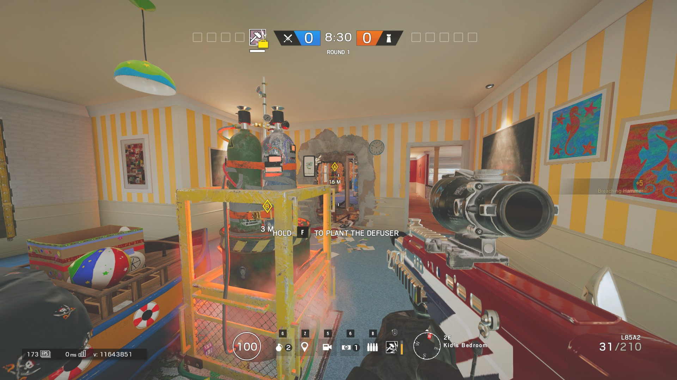
Rainbow Six Siege
First-Person Shooter (FPS) game
5 defenders and 5 attackers
Ranked mode : 2 bomb sites, 1 defuser

Slide 24
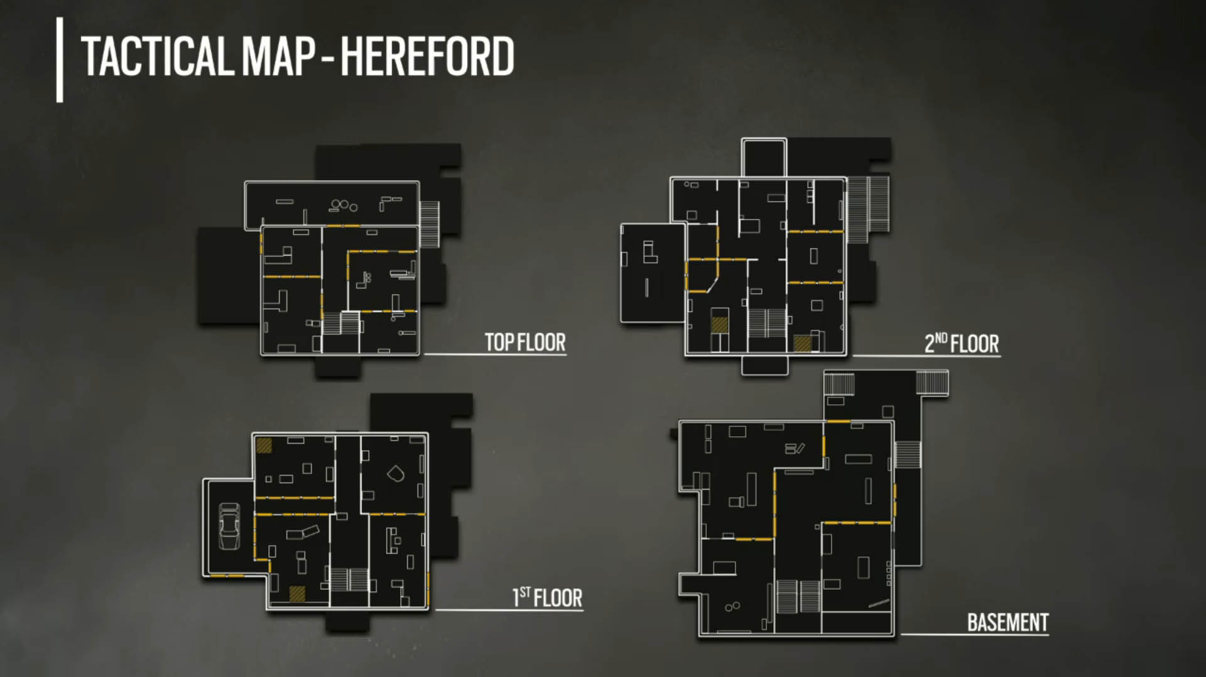
Map

Slide 25
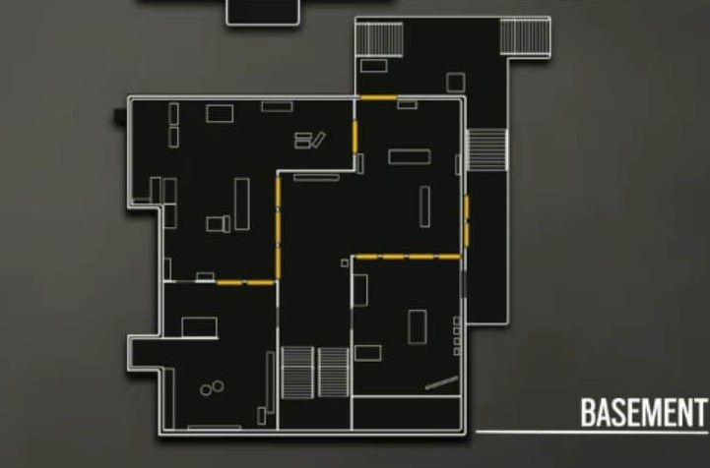
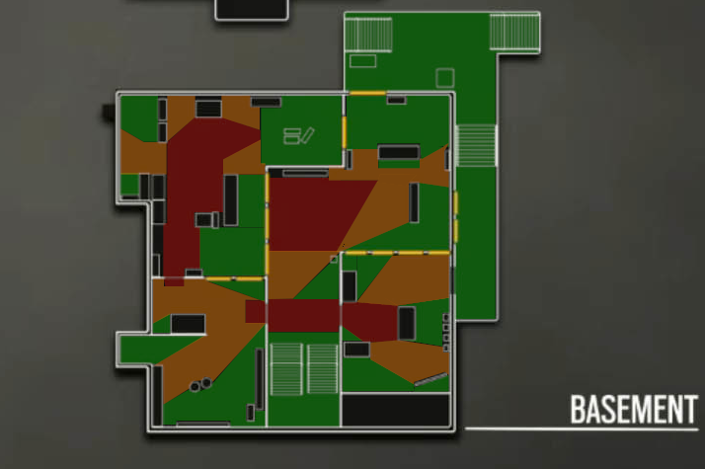
Our goal
Find the level of danger per region

Slide 26
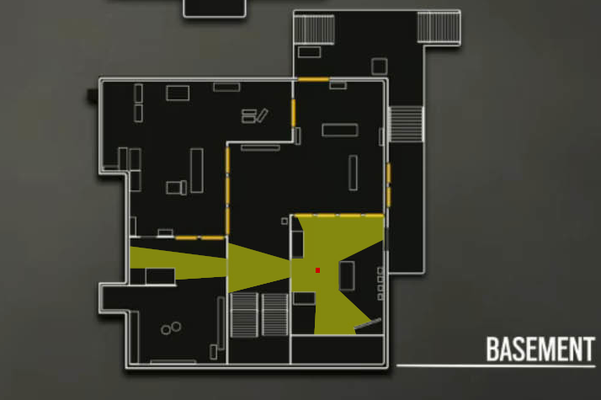
Solution proposed
Field of view (360°)
Big surface ⬄ high level of danger
Small surface ⬄ low level of danger

Slide 27
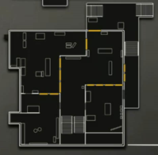
Original image

Slide 28
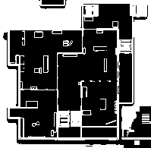
Segmented image

Slide 29
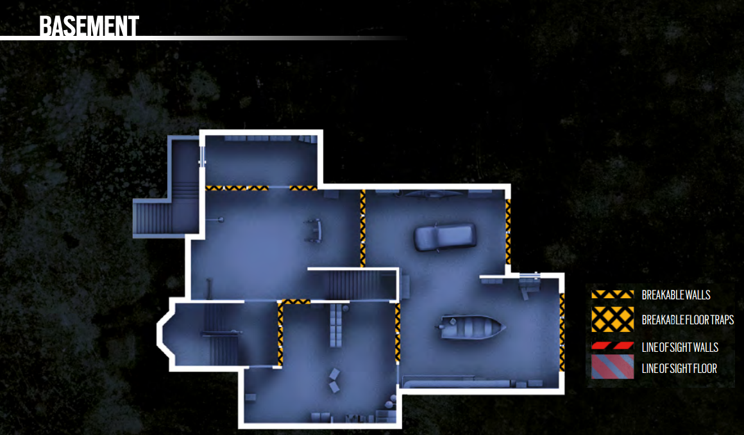
Better resolution

Slide 30
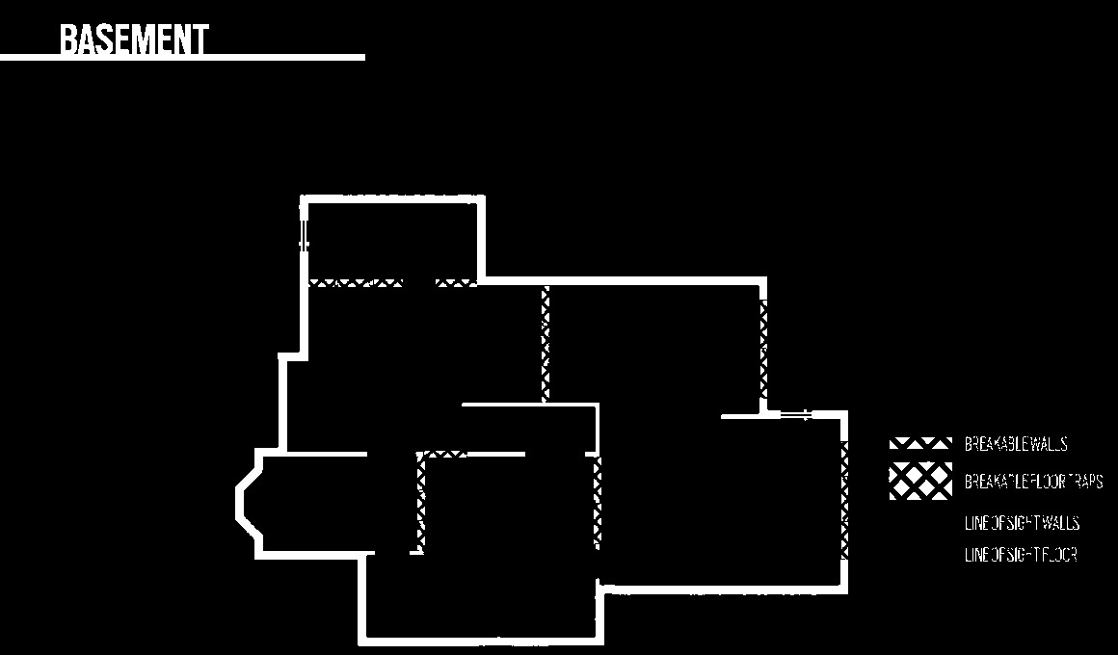
Segmentation

Slide 31
Problems…
Image quality
Obstacles segmentation
Voxlogica limitation

Slide 32

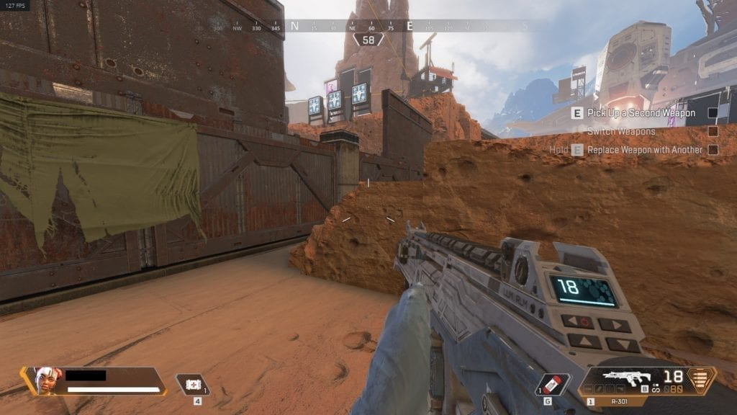
Apex Legends
First-person shooter (FPS) Battle Royale
20 squads of 3 members
Dropping from a plane

Slide 33
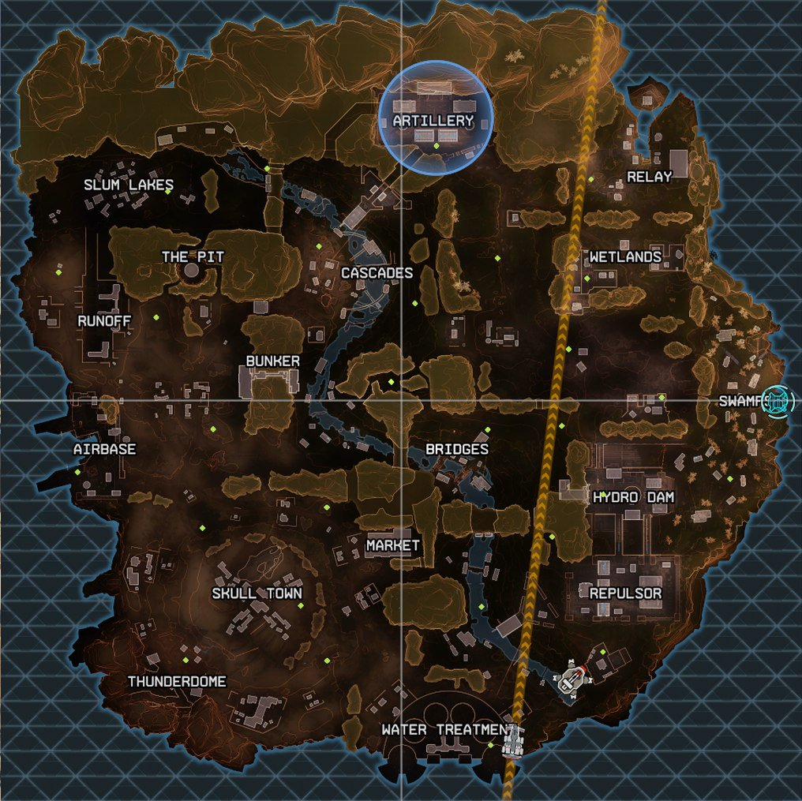
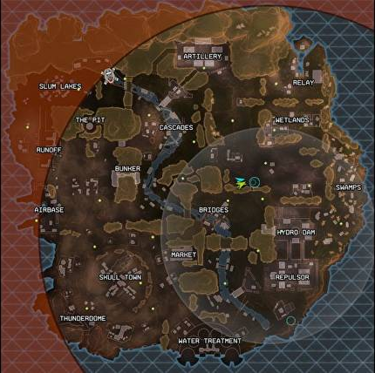
Drop and Safe

Slide 34
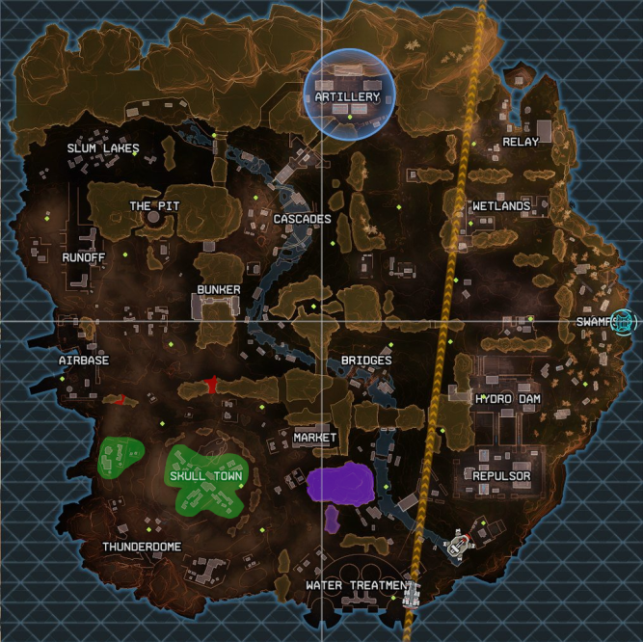
Buildings, Chokes and Mountains Segmentation

Slide 35
Map design analysis
Percentage of unreachable zone
Percentage of looting area
Percentage of strategy point

Slide 36
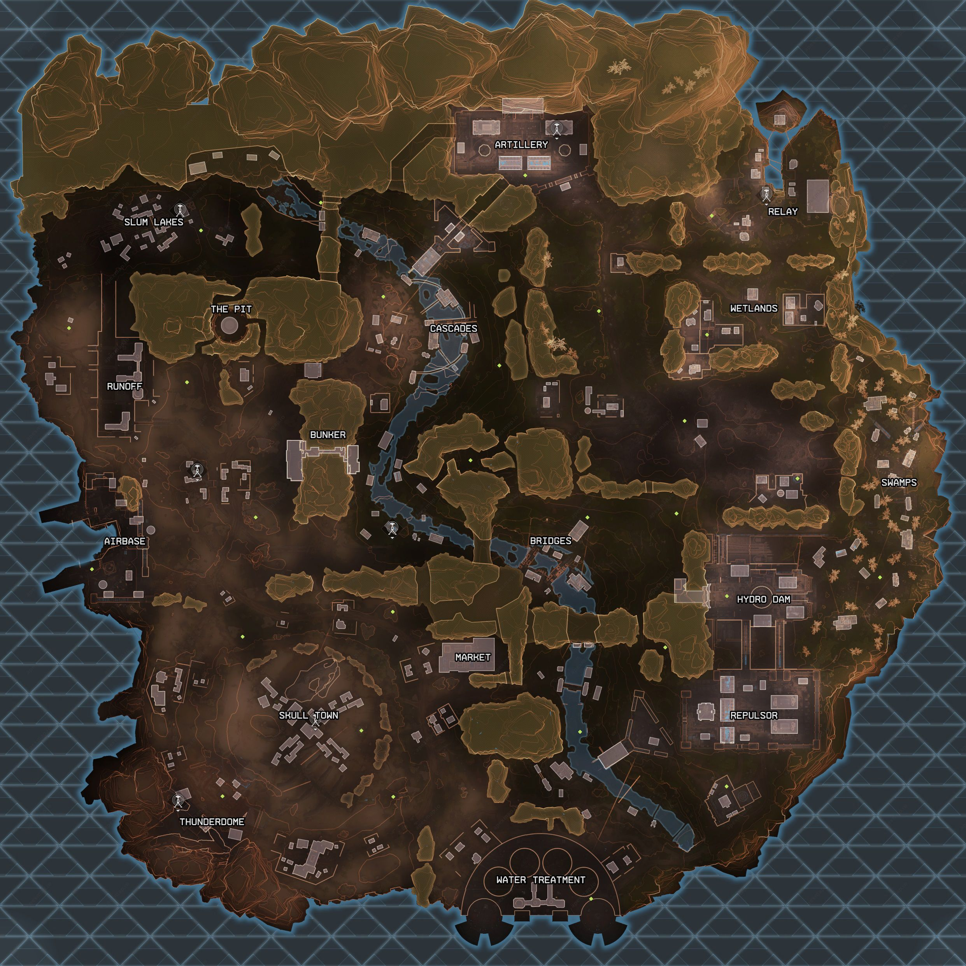
Buildings segmentation using Voxlogica

Slide 37
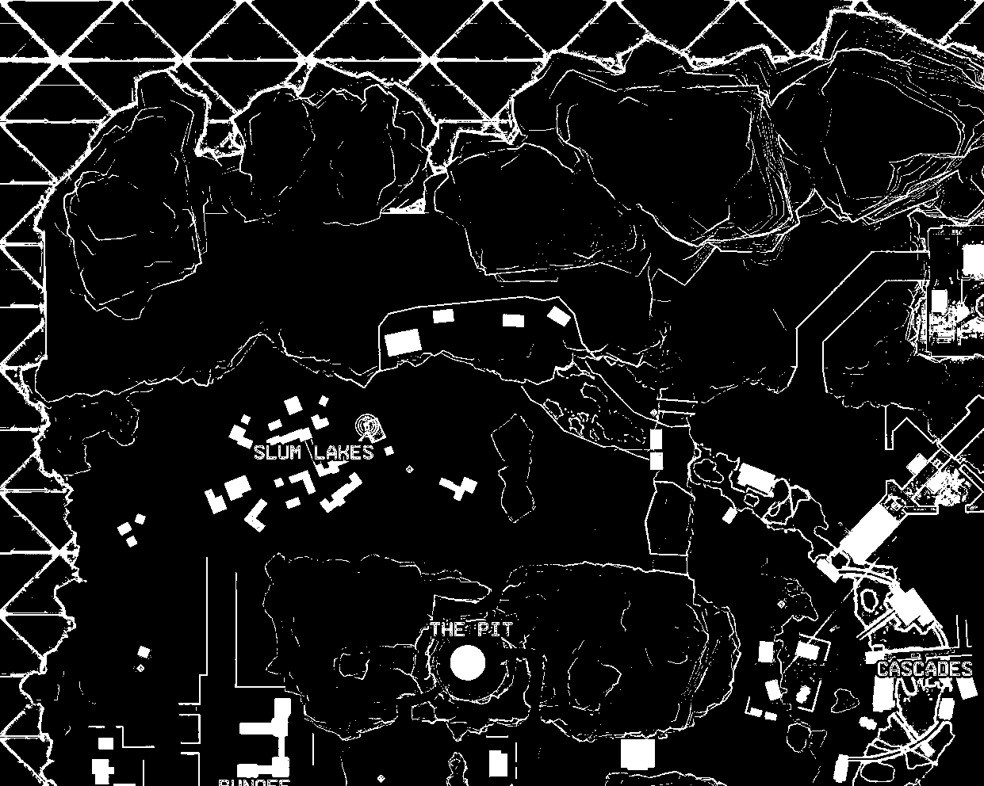
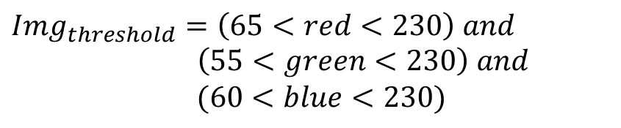
Color Threshold
$$Img_{threshold}=\left(65<red<230\right) and$$
$\left(55<green<230\right) and$
$$(60<blue<230)$$

Slide 38
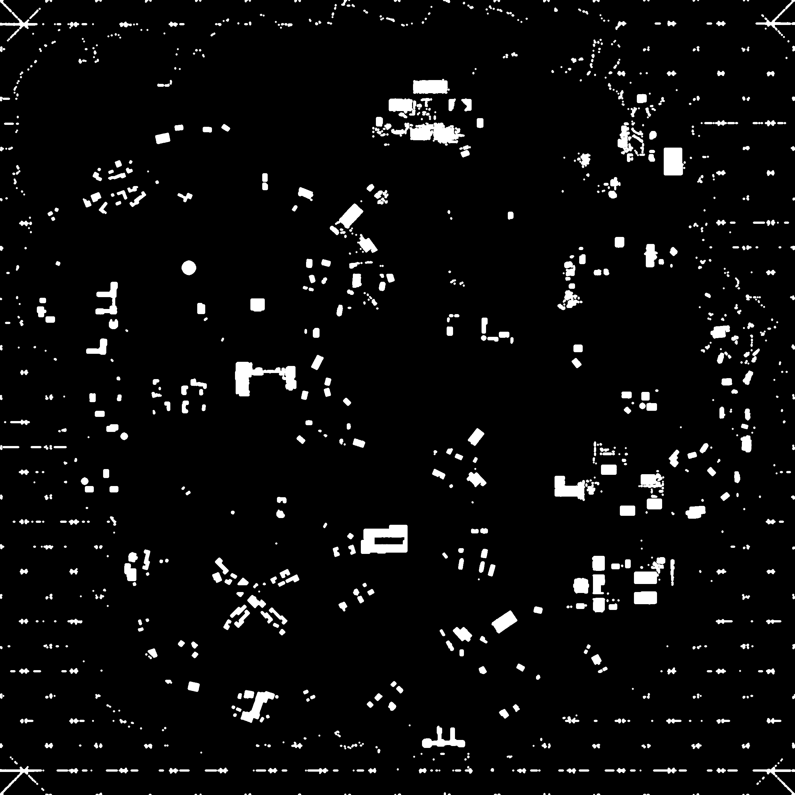
Smooth Filter
$$Img_{filtered}=flt_{3}\left(Img_{threshold}\right)$$

Slide 39

Zone definition
$$Zone=D^{≤160} Slum_{centers}$$

Slide 40

Segmentation
$SlumBuildings_{binary}=Img_{filtered} and Zone$

Slide 41

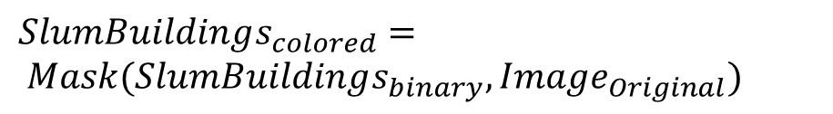
Slum Lakes Buildings
$$SlumBuildings_{colored}=$$
$$Mask(SlumBuildings_{binary}, Image_{Original})$$

Slide 42
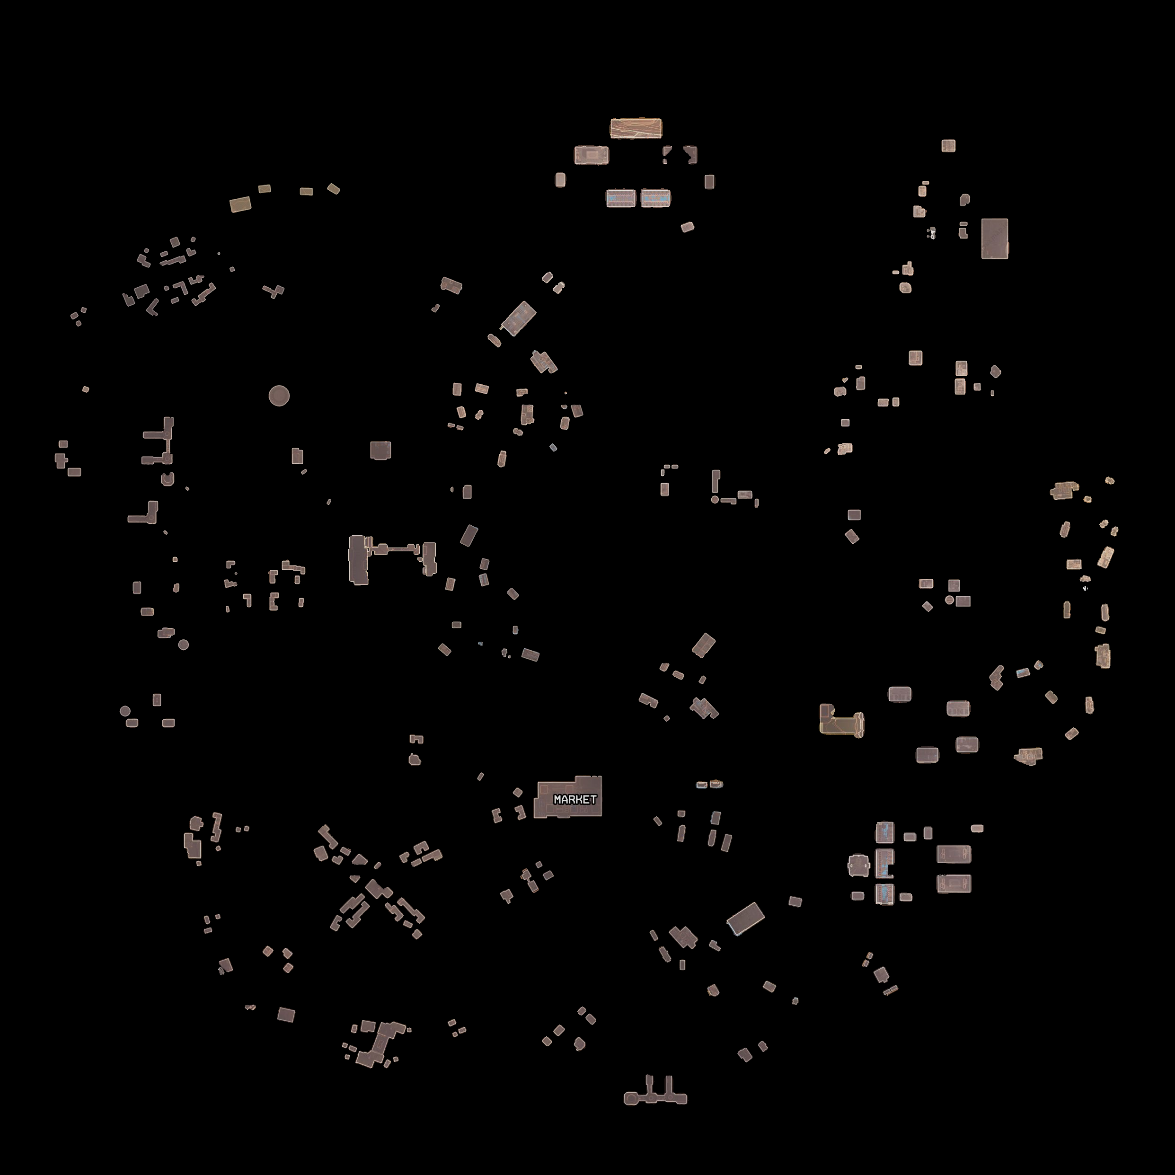
Final segmentation

Slide 43
Mountains segmentation using Voxlogica

Slide 44
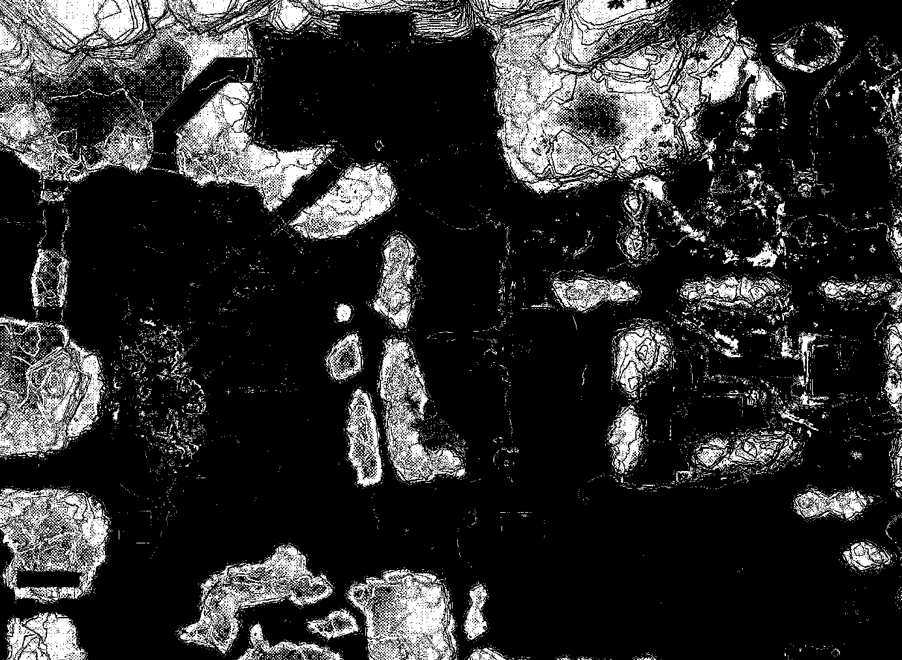
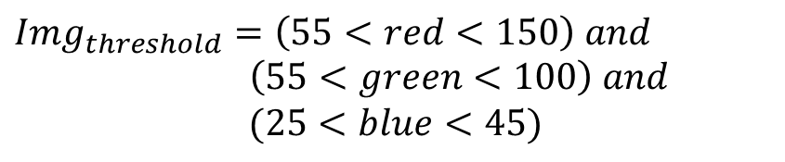
Color Threshold
$$Img_{threshold}=\left(55<red<150\right) and$$
$\left(55<green<100\right) and$
$$(25<blue<45)$$

Slide 45
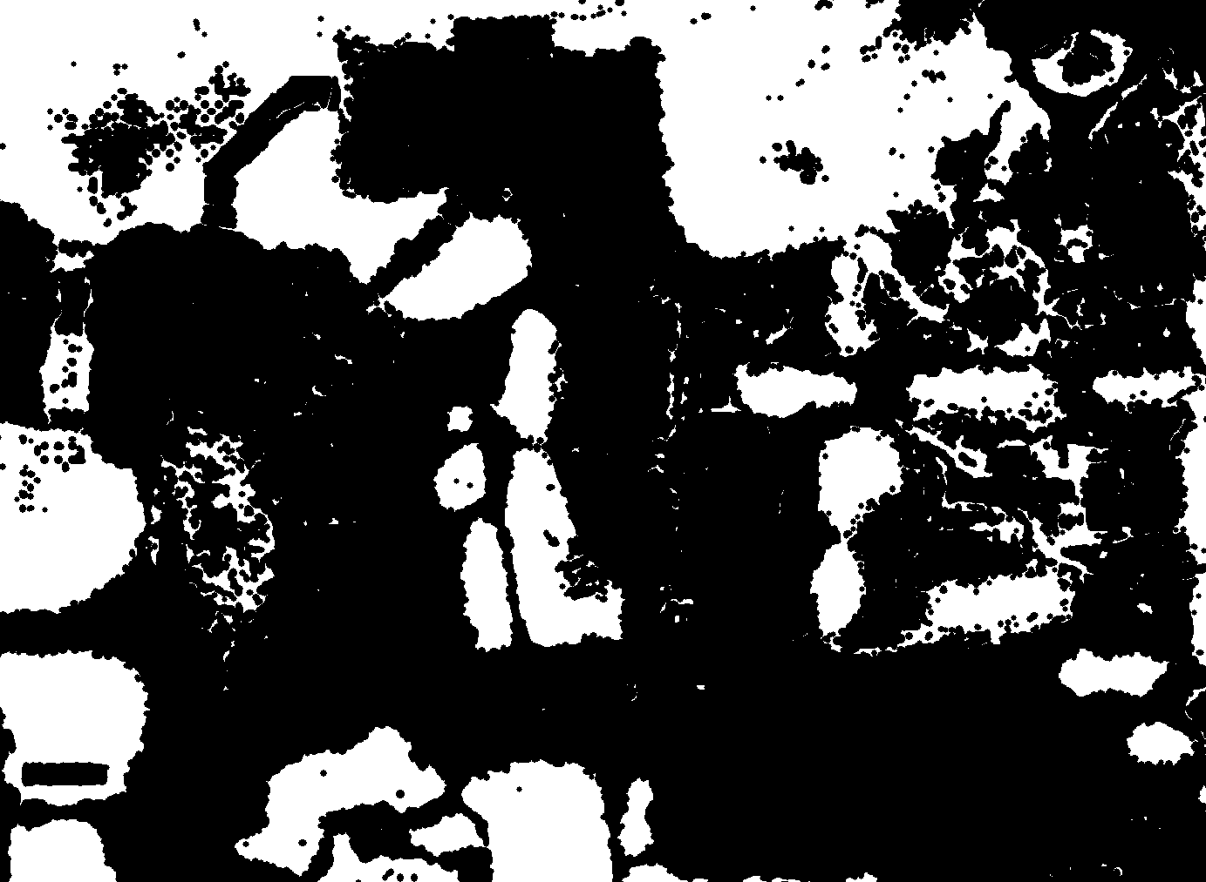

Smooth Filter
$$Img_{filtered1}=not(flt_{3}\left(not(Img_{threshold}))\right)$$
$={not(D}^{≤3}(D^{≥3} not\left(Img_{threshold}\right)))$

Slide 46
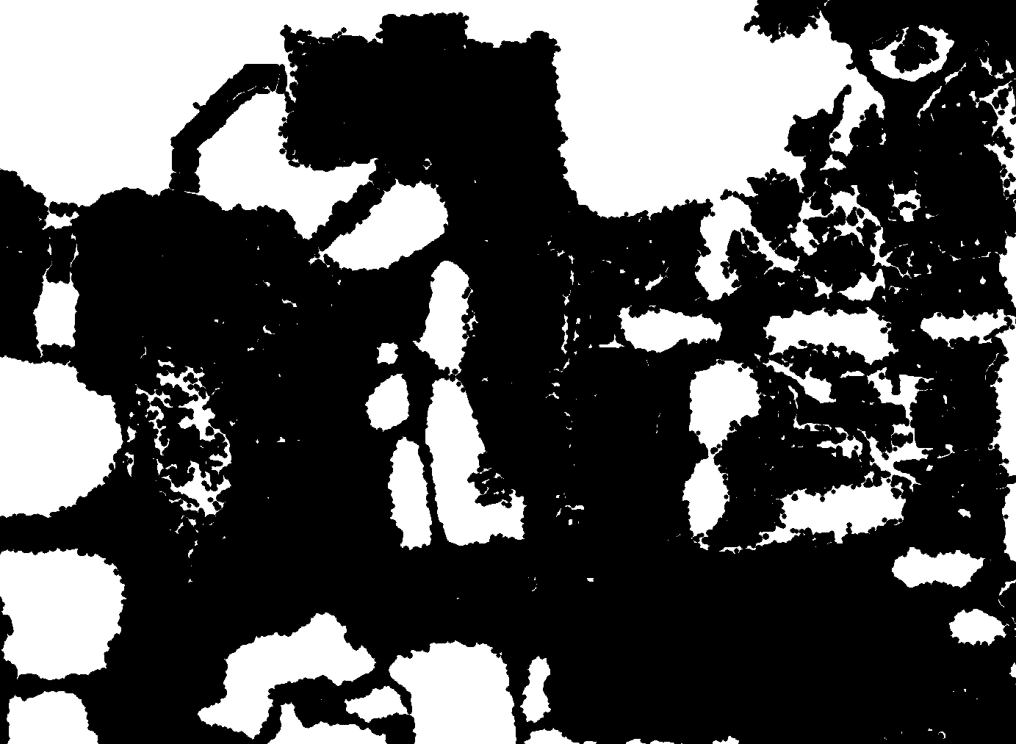

Smooth Filter
$$Img_{filtered2}=$$
$not(touch\left(not\left(Img_{filtered1}\right), border)\right)$

Slide 47
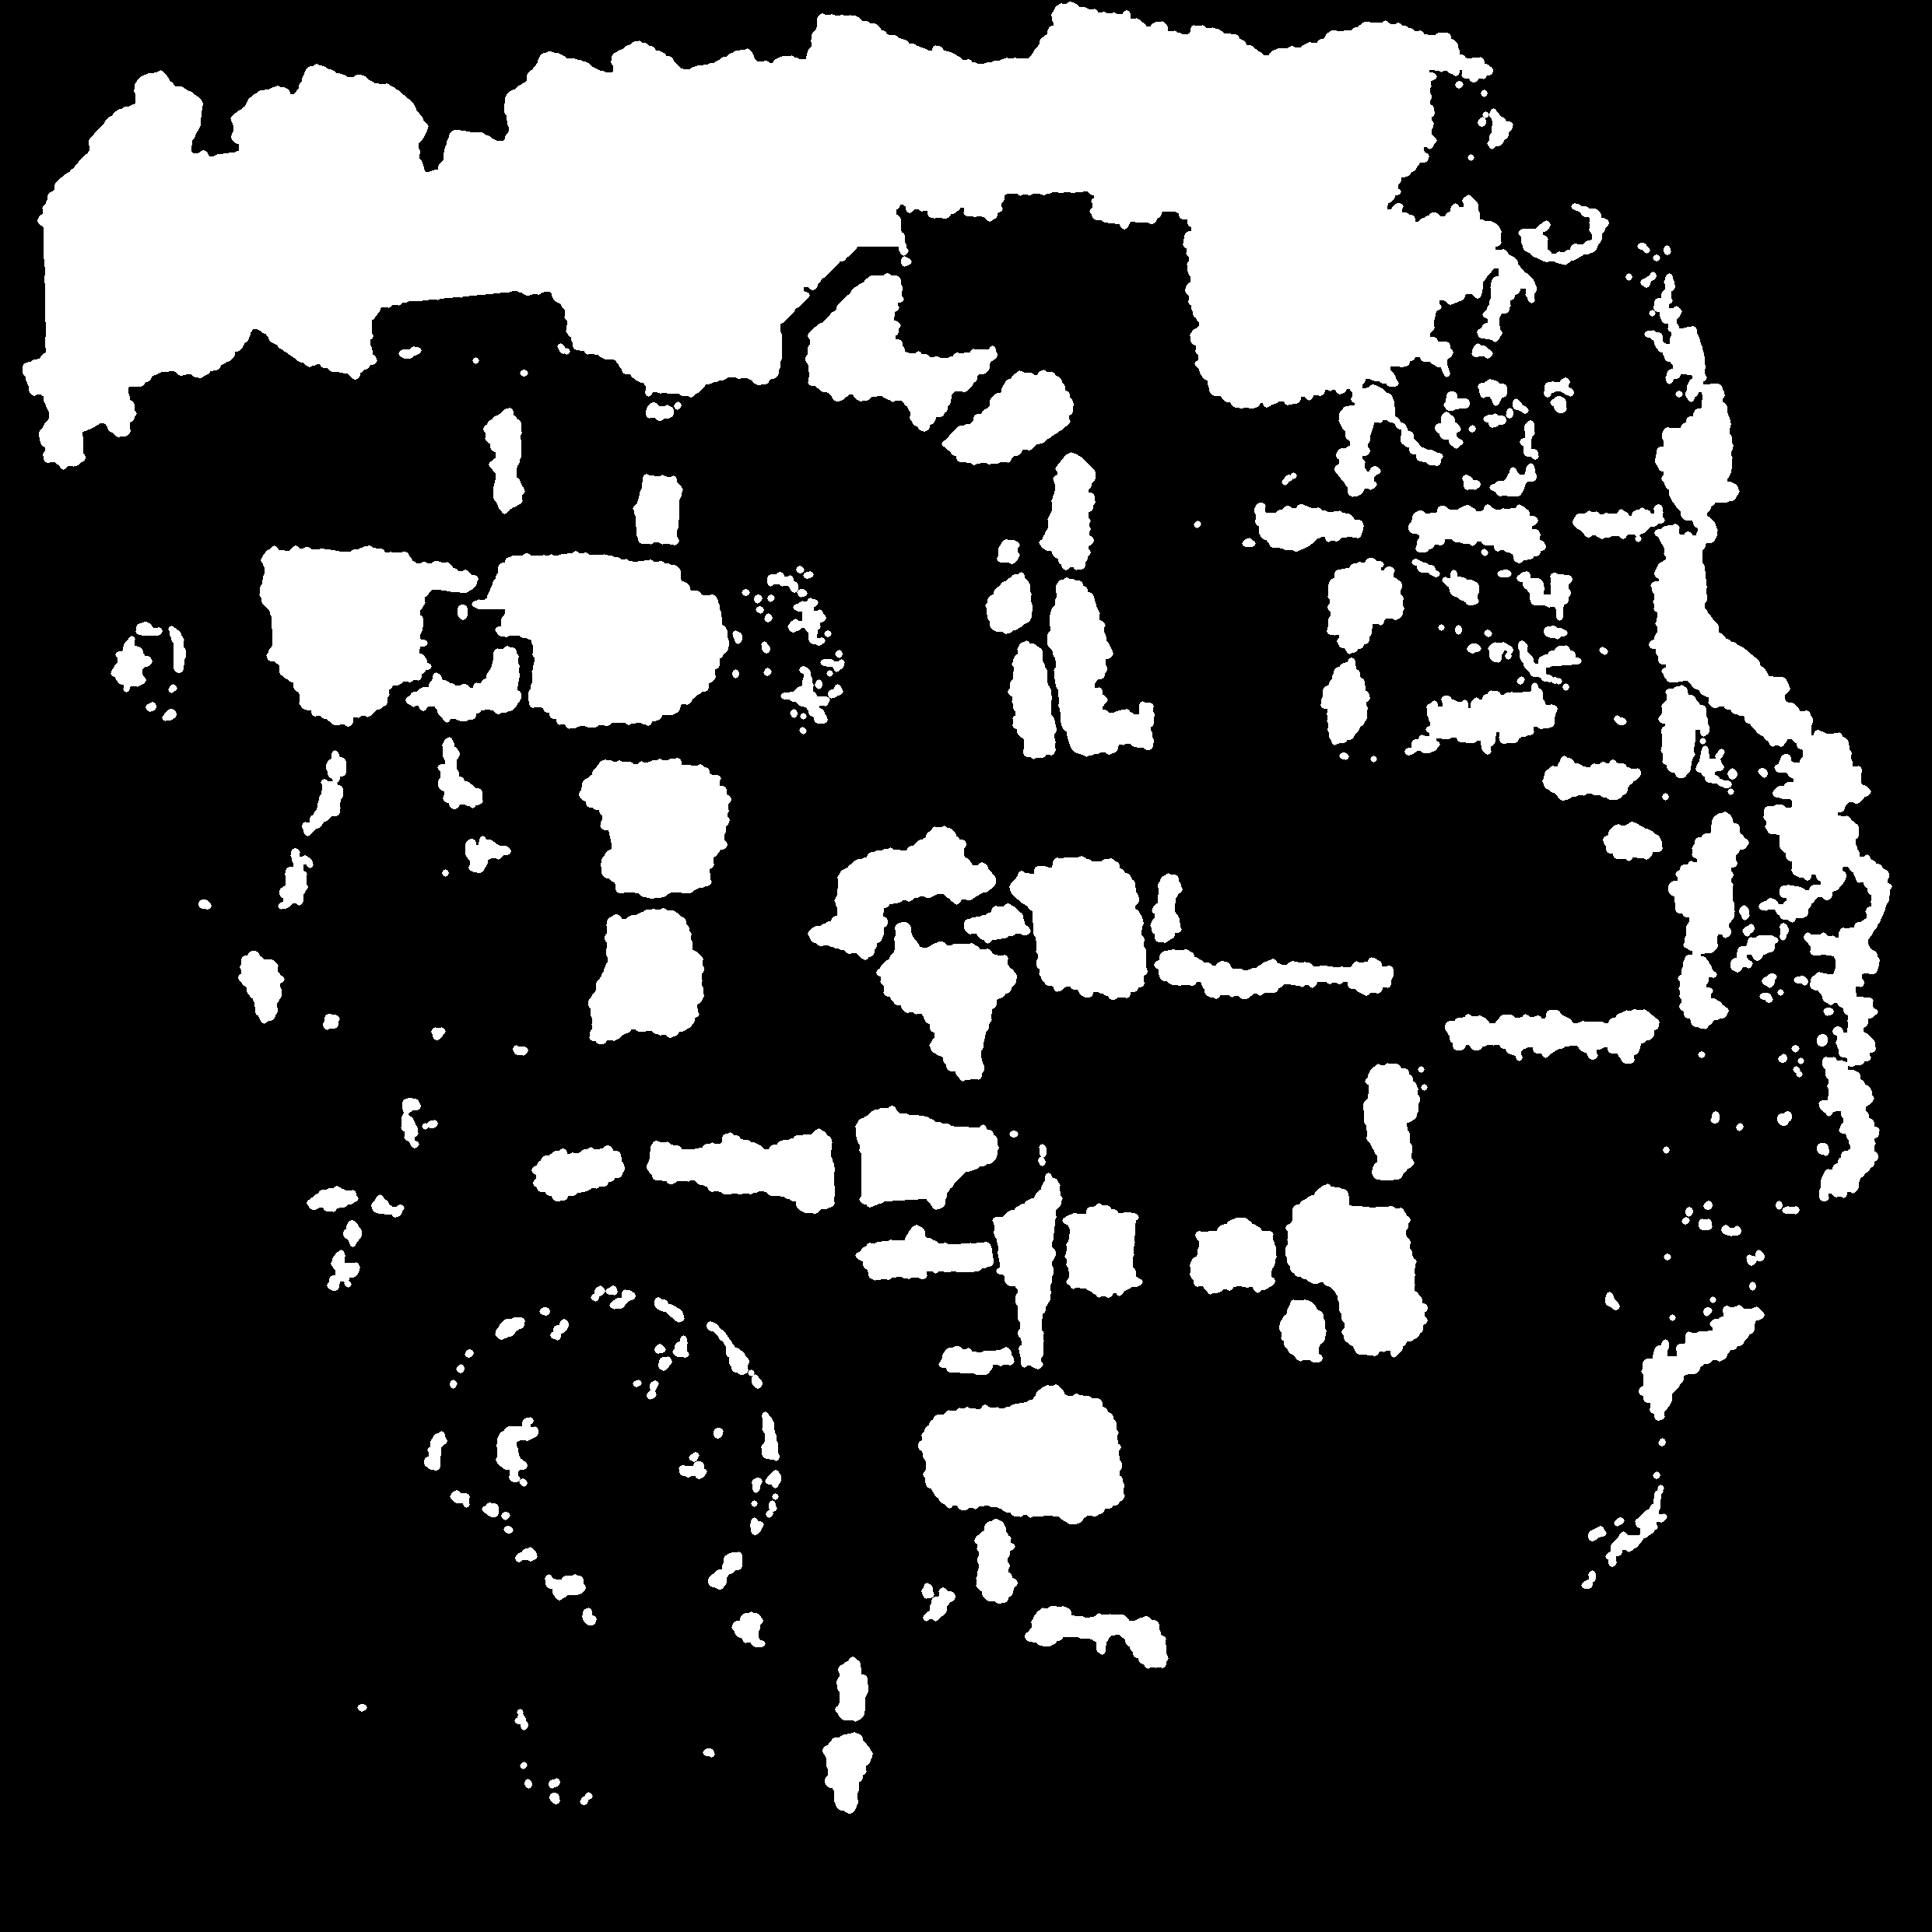
Smooth Filter
$$Img_{filtered3}=flt_{6}\left(flt_{3}(Img_{filtered2})\right)$$

Slide 48

Zone definition
$$Zone=D^{≤250} Artillery_{centers}$$

Slide 49
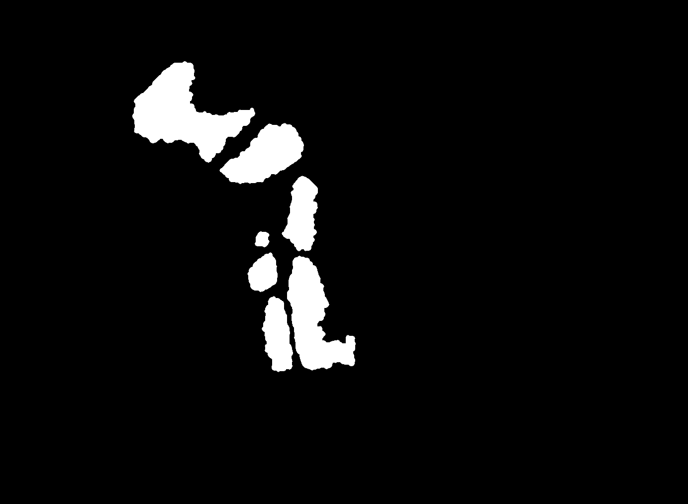
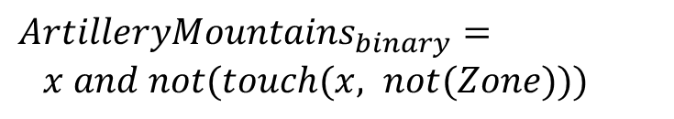

Segmentation
$$ArtilleryMountains_{binary}=$$
$x and not(touch(x, not(Zone)))$
Where$:x=Img_{filtered4} and Zone$

Slide 50


Artillery mountains
$$ArtilleryMountains_{colored}=$$
$$Mask(ArtilleryMountains_{binary}, Image_{Original})$$

Slide 51

Final segmentation

Slide 52

Github repository
Docs
Apex
Rainbow
Buildings
Mountains
Src
Output
Output
Src

Slide 53

Agenda

Slide 54
Topological Reasoning
Jonathan Lo, Tommaso Peletta, Adrien Razurel

